Slide 1
Swift Machine Learning Model Serving Scheduling: A Region Based Reinforcement Learning Approach
Author: Heyang Qin, et. al.
Presented By: Zhou Yang

Slide 2
Table of Contents
INTRODUCTION
BACKGROUND AND RELATED WORK
RRL-BASED SCHEDULING FRAMEWORK
REGION-BASED REINFORCEMENT LEARNING
IMPLEMENTATION
Experimental
CONCLUSION AND FUTURE WORK

Slide 3
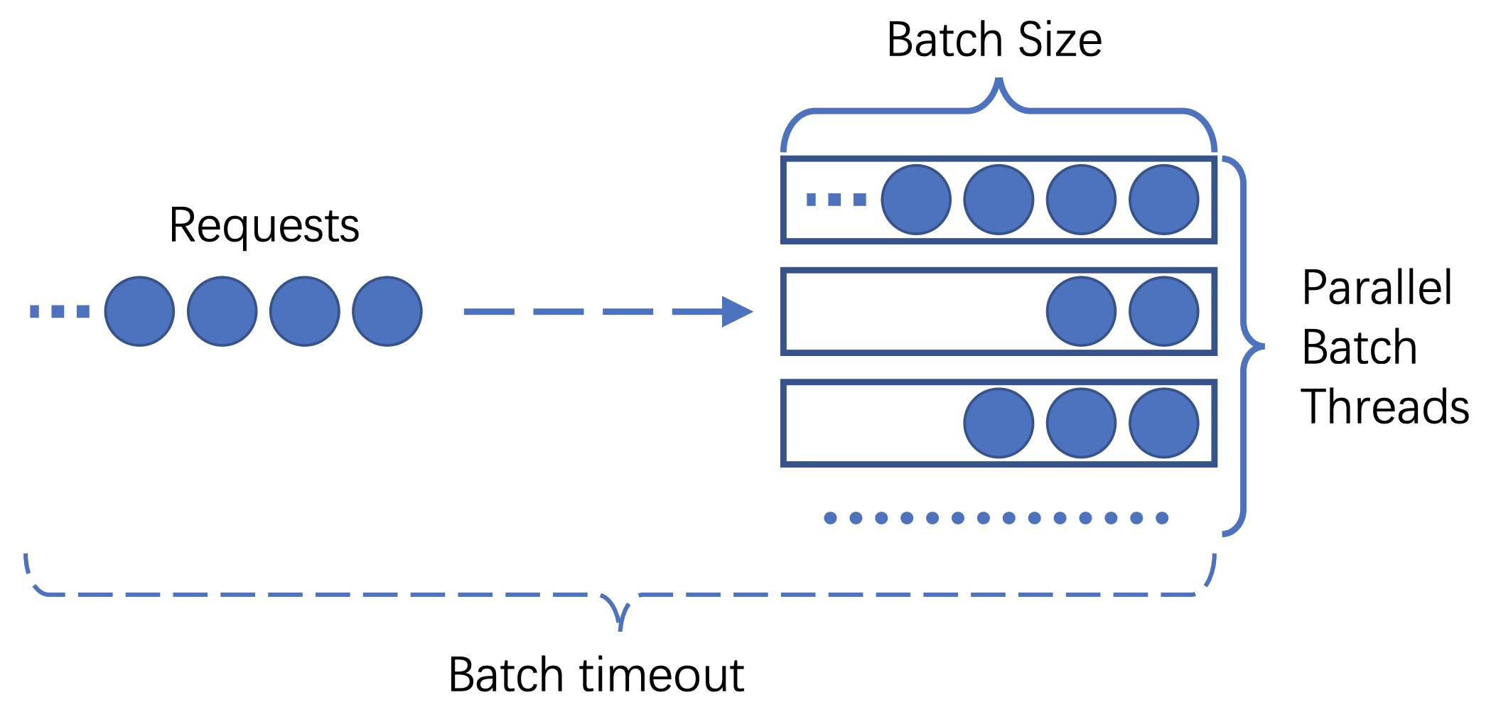
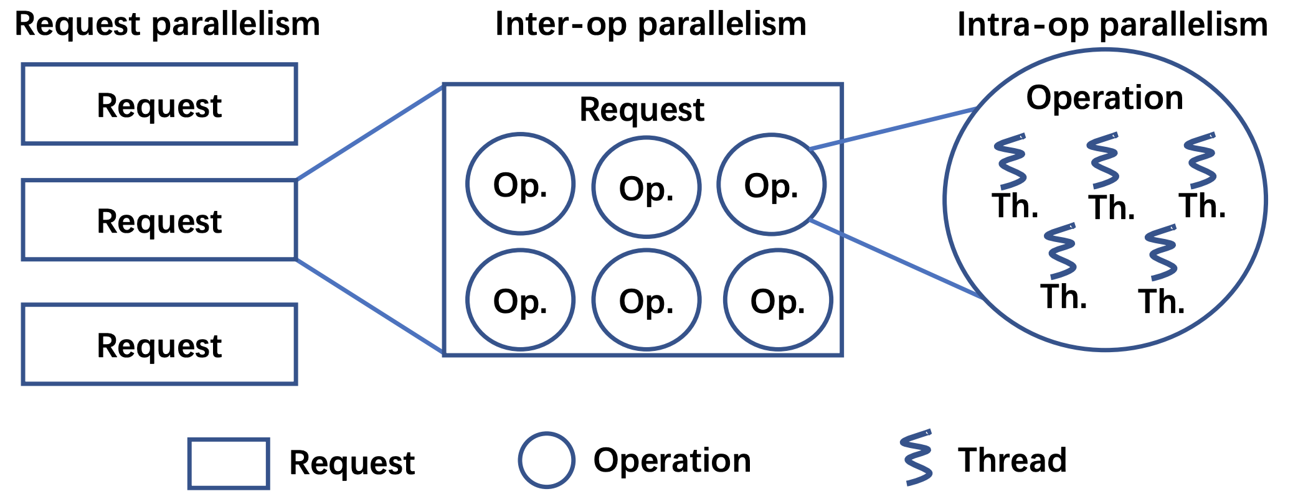
INTRODUCTION
Motivations
  Background: machine learning is popular in a variety of applications
  Gap: machine learning service take minutes to fulfil requests ( models contain billions of neural connections), typical Service Level Objective (SLOs) of MLaaS in production system require 500-800ms
  Solution: parallelism (running ML models on CPU)
    request parallelism: requests can be executed in parallel
    operation parallelism:
      inter-op parallelism: multiple operations running simultaneously
      intra-op parallelism: each operation utilizes multiple threads

Slide 4
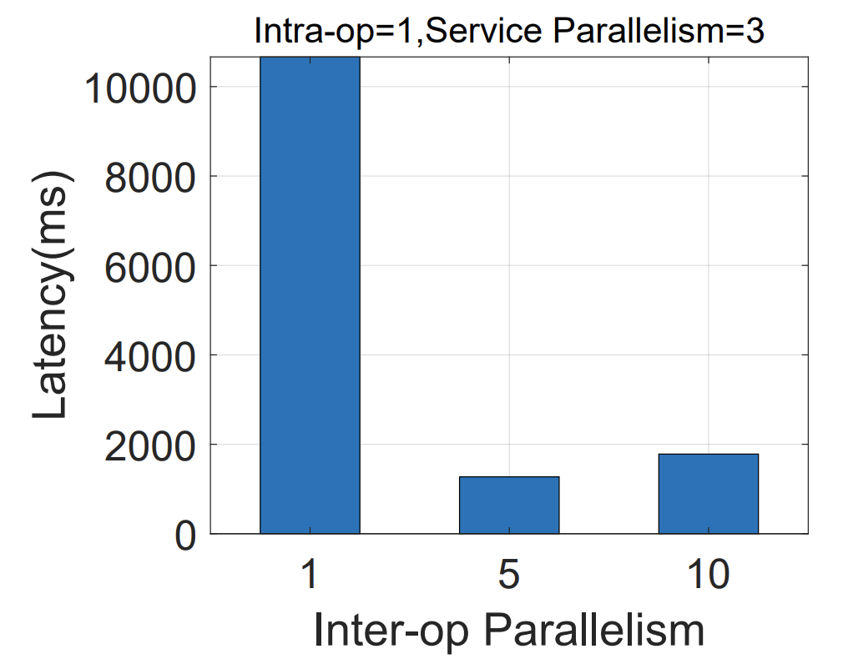
INTRODUCTION
Motivations
  operation parallelism:
    inter-op parallelism: multiple operations running simultaneously
    intra-op parallelism: each operation utilizes multiple threads
Parallelism configuration has significant impact on system performance.

Slide 5
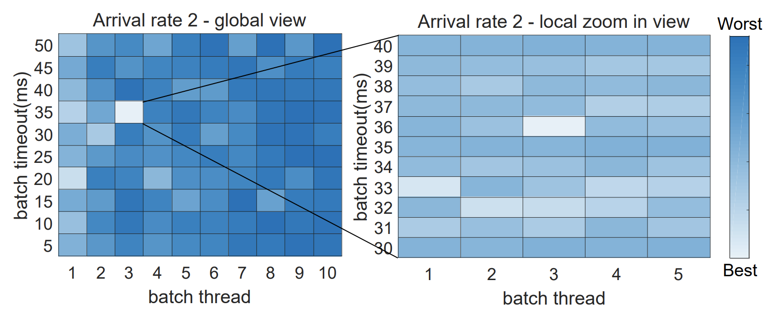
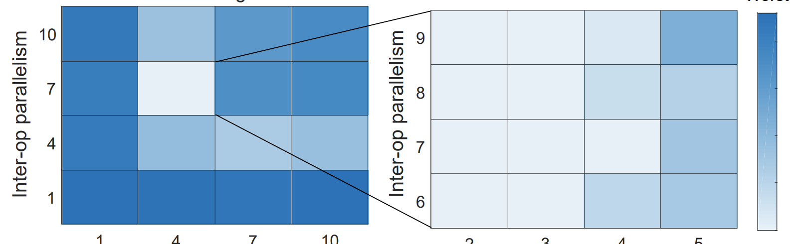
INTRODUCTION
Challenges
  ML-serving involves thousands of operations with complex correlation among them, which makes it challenging to model in a white-box manner.
  makes machine learning serving an unique workload that is challenging to breakdown and do fine-tuning at operation level.
  Challenges in parallelism configuration:
    domain specific information and techniques to tune the parallelism configuration

Slide 6
INTRODUCTION
Contributions:
  propose a swift machine learning serving scheduling framework to solve the above challenges.
  The proposed framework is driven by a light-weight-region-based reinforcement learning (RRL) approach

Slide 7
BACKGROUND AND RELATED WORK
Several machine learning serving systems have been open-sourced recently. i.e.: tensorflow serving
  Hardware acceleration has been used to accelerate the computation in machine learning serving by using customized hardware such as GPUs, FPGAs, and ASICs
  Parallelism: reducing the latency of ML serving, vector-matrix multiplications or matrix-matrix multiplications

Slide 8
BACKGROUND AND RELATED WORK
Interactive Serving:
  parallelism to accelerate processing or share resources among users’ requests.

Slide 9
BACKGROUND AND RELATED WORK
Several machine learning serving systems have been open-sourced recently. i.e.: tensorflow serving
  Hardware acceleration has been used to accelerate the computation in machine learning serving by using customized hardware such as GPUs, FPGAs, and ASICs
  Parallelism: reducing the latency of ML serving, vector-matrix multiplications or matrix-matrix multiplications

Slide 10
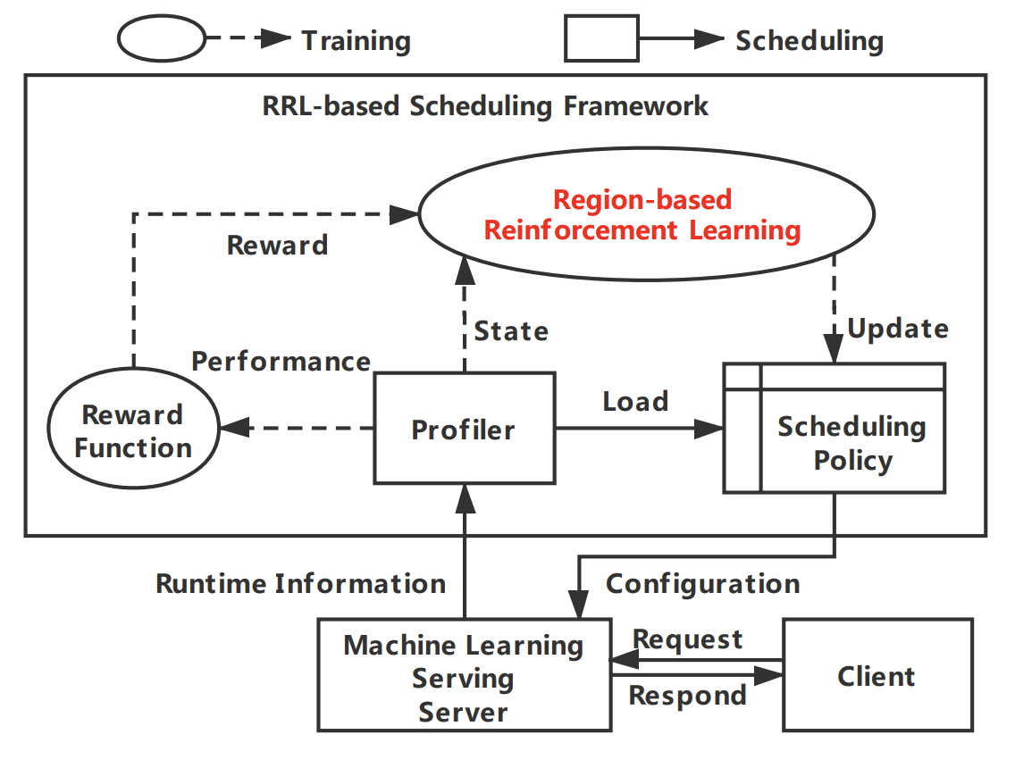
RRL-BASED SCHEDULING FRAMEWORK

Slide 11
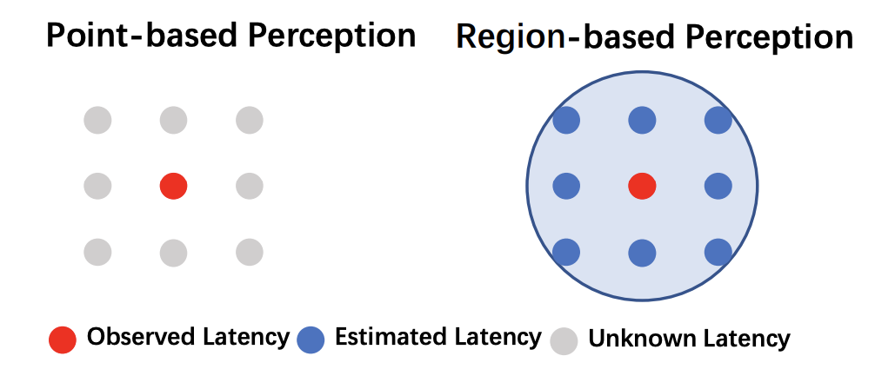
REGION-BASED REINFORCEMENT LEARNING

Slide 12
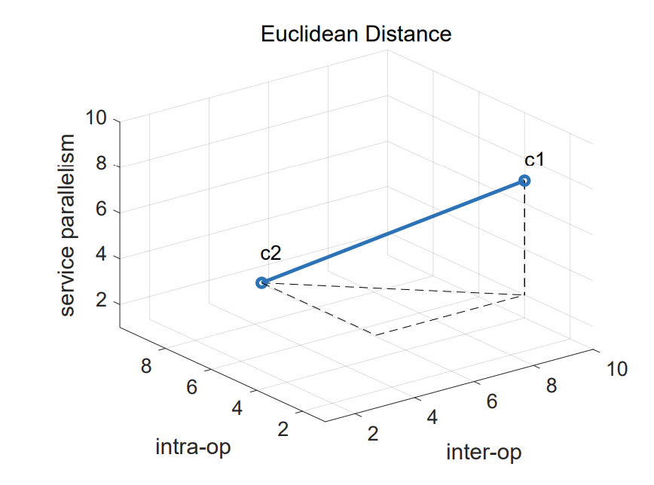
REGION-BASED REINFORCEMENT LEARNING

Slide 13
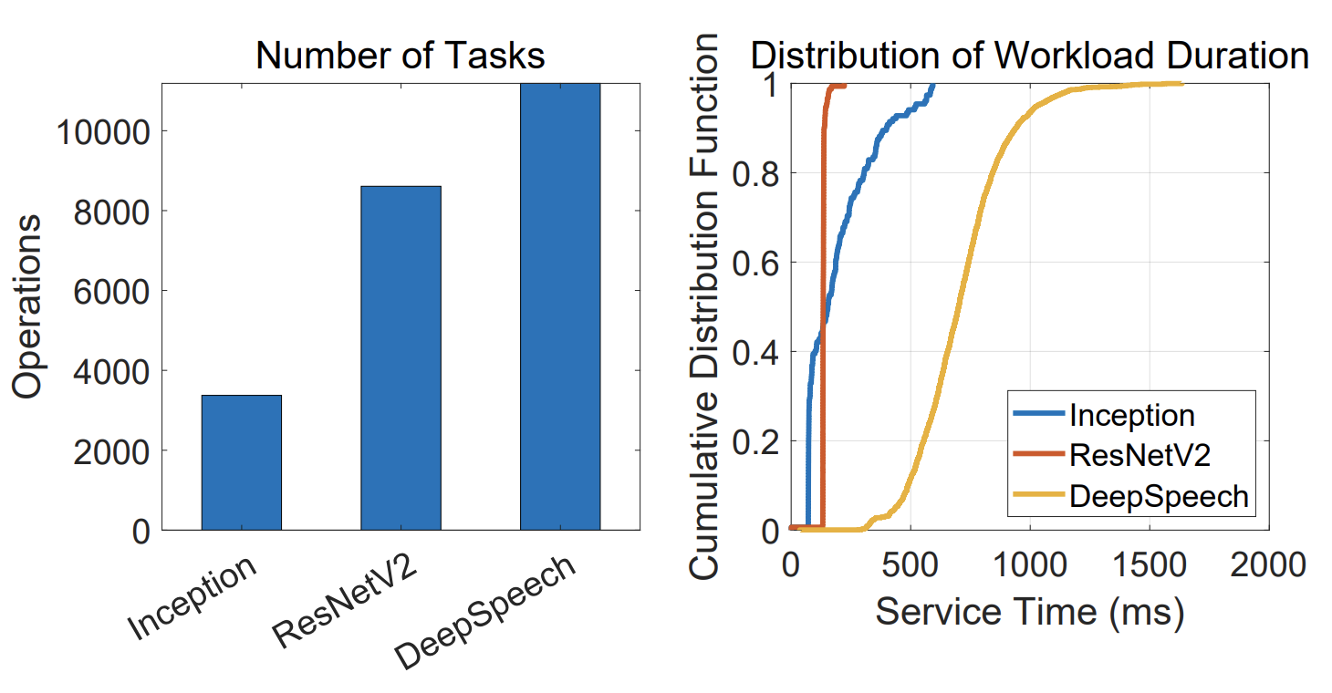
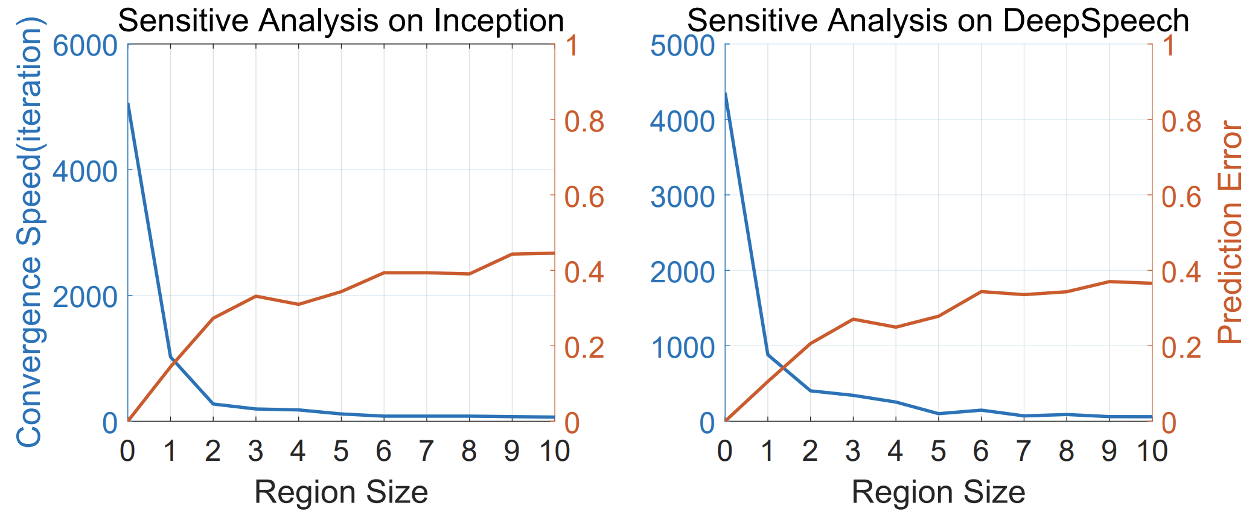
IMPLEMENTATION
Neural Network based Estimation Function

Slide 14
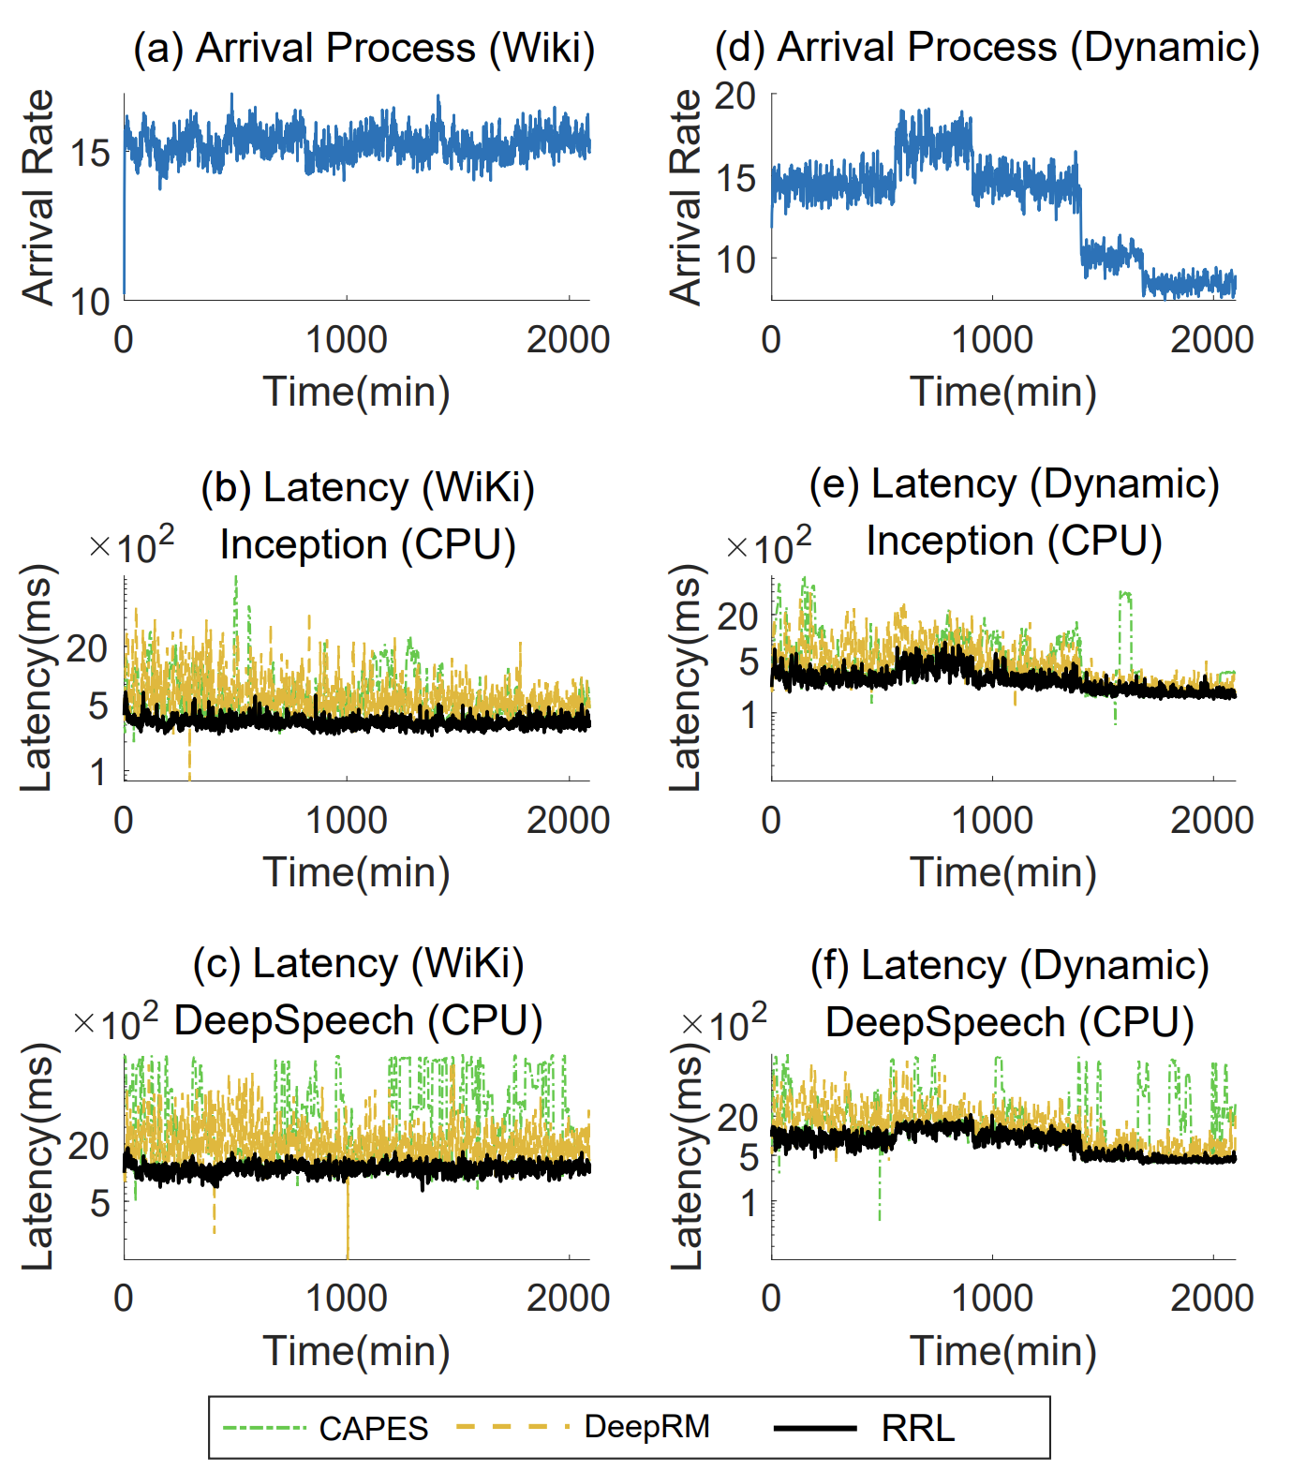
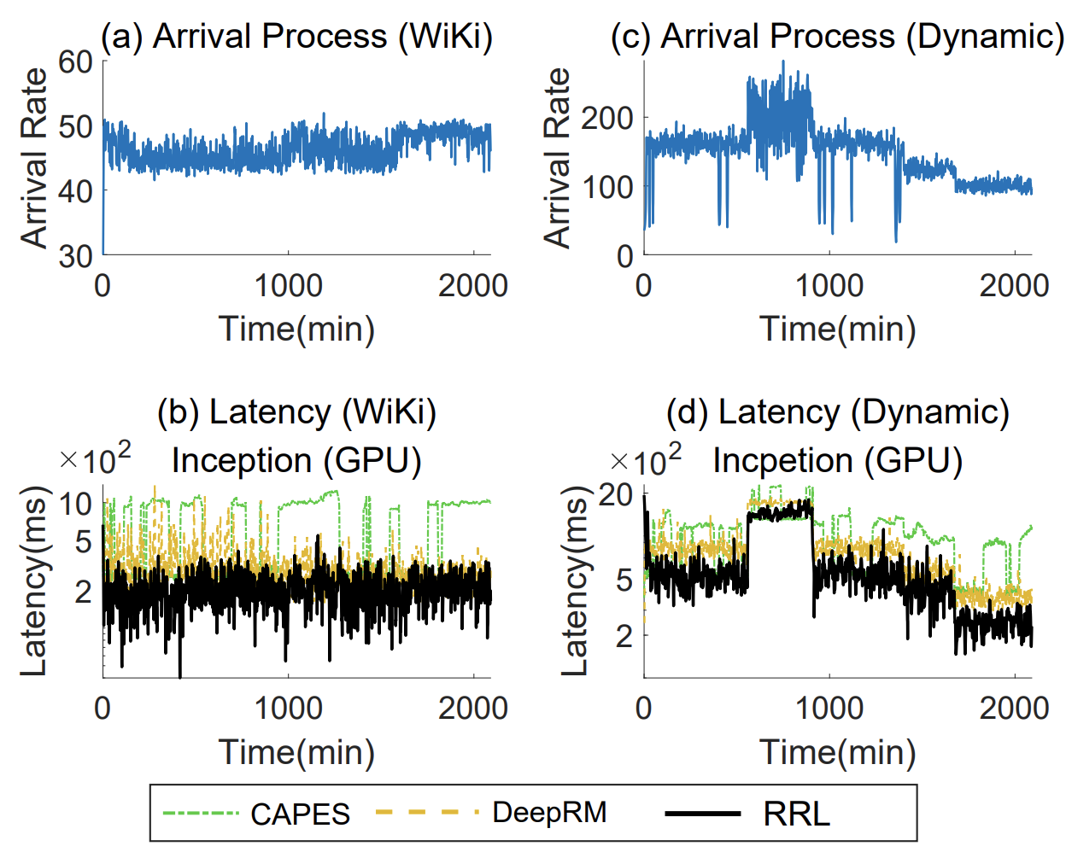
Experimental

Slide 15
CONCLUSION AND FUTURE WORK
In this paper, we proposed a RRL-based scheduling framework for machine learning serving that can efficiently identify the optimal configuration under dynamic workloads.
A key observation is that the system performance under similar configurations in a region can be accurately estimated by using the system performance under one of these configurations, due to their correlation, based on which we developed the RRL approach.

